Slide 1
Lexical Analysis
Oh my word!

Slide 2
Compilers and Interpreters
You have used Java, a compiler.
You might have used an interpreter – Python or JavaScript are two popular examples.
On the inside, they are mostly the same until you get to the end of the process.

Slide 3
Compiler/Interpreter Architecture
In the old days, compilers were broken up into many parts because the computers were small It turns out that even with big, fast computers, that division of tasks is very useful.
We will talk briefly about that architecture and then discuss the first component – lexical analysis

Slide 4

My Program
???????
Compiled Code!
Lexical Analyzer
Parser
Semantic Analysis
Optimization
Code Generator

Slide 5
So how do we get there?
Lexical Analyzer

Slide 6
lexical adjective lex·i·cal \ˈlek-si-kəl\
of or relating to words or the vocabulary of a language as distinguished from its grammar and construction
In computer science, lexical analysis is the process of converting a sequence of characters (such as in a computer program or web page) into a sequence of tokens (strings with an identified "meaning"). A program that performs lexical analysis may be called a lexer, tokenizer, or scanner (though "scanner" is also used to refer to the first stage of a lexer). Such a lexer is generally combined with a parser, which together analyze the syntax of programming languages, web pages, and so forth.

Slide 7


Slide 8
We are going to look at the incoming text of a “program” and convert it into known words.

Slide 9
We do something like this when we read…
The quick brown fox, happily, jumped over the lazy dog.
Think about the process that you learned when you were a few years old. You might have moved your finger along the letters until you hit something that was not a letter.
T-h-e : that spells “the”
q-u-i-c-k: that spells “quick”
That’s the general idea behind lexical analysis!

Slide 10
Lexical analysis for reading
The quick brown fox, happily, jumped over the lazy dog.
while current is a letter
add current to our “buffer”
move one character to the right
sound out our “buffer”

Slide 11
How about numbers?
21 .32 7.9
while current is a digit or decimal point
add current to our “buffer”
move one character to the right
read our “buffer” using the rules for numbers
The rules are nearly identical!

Slide 12
How does this relate to programming?
Think of a string - our job is to take characters from the string, one after another, until we run out.
As we hit the end of each type of data item (word, number), we output it as an identified item (called a token).

Slide 13
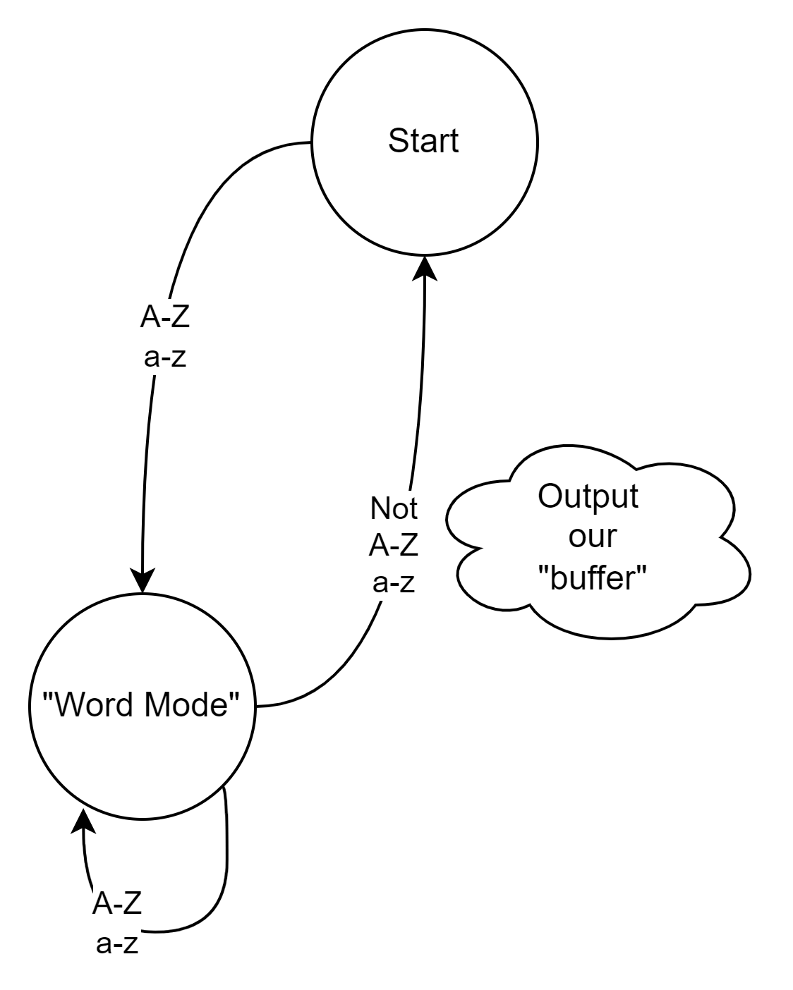
We could do this with state machines
Of course, the number state machine looks very similar.
There is one minor problem – that “Not A-Za-z” line uses a character.
What if that character matters?
“hit,Tom” is very different from “hit Tom”

Slide 14
That’s kind of cool, I get that, I guess, but how does that pertain to programming languages?

Slide 15
So, let’s take a simple language. How about a “normal” infix calculator?
Infix means the operation is “inline”:
2 + 3 = 5

Slide 16
What “words” might you find in an infix calculator?
+ - * / = “numbers”

Slide 17
To avoid confusion later when we are dealing with programs, let’s change those to words:
plus minus times divide equals “numbers”

Slide 18
Let’s build a state machine with “side effects”

Slide 19
[0-9]
Output “plus”
Output “number”
λ
Output “minus”
+
.
[0-9]
[0-9]
λ
-
.
Start
*
=
“Output” creates output and goes back to the start state.
Assume that any other character is handled in some way outside of this state machine – a topic for later
Output “times”
/
Output “divide”
Output “equals”

Slide 20
You might notice 2 things:
This seems like a pointless exercise – you are converting + to “plus” – big deal
The only part of the exercise that makes any sense, dealing with numbers, loses the value of the number – we Output “number”

Slide 21
You might notice 2 things:
This seems like a pointless exercise – you are converting + to “plus” – big deal
Yes, but – you are ensuring that everything that comes out is trusted – that the output stream is guaranteed to be reasonable. Also, we won’t Output the word as a string (sneak peek – we will generate an enum that gets output)

Slide 22
You might notice 2 things:
2) The only part of the exercise that makes any sense, dealing with numbers, loses the value of the number – we Output “number”
That’s a good point – and another reason to talk about our actual output!

Slide 23
Let’s talk about output
We started with a stream of characters.
Our output need to be something that is significantly better (easier to deal with) than that in order to make this a useful program
We need two things – the type of item and the value of the item.

Slide 24
We do something like this when we read…
The quick brown fox, happily, jumped over the lazy dog.
What words are in this sentence?
What punctuation?
What nouns?
What verbs?
What adjectives?
What adverbs?
What articles?

Slide 25
The quick brown fox, happily, jumped over the lazy dog.
Text: The
Type: Article
Text: quick
Type: Adjective
Text: brown
Type: Adjective
Text: fox
Type: Noun
Text: ,
Type: Punctuation
Text: happily
Type: Adverb
Text: ,
Type: Punctuation
Text: jumped
Type: Verb
Text: over
Type: Preposition
Text: the
Type: Article
Text: lazy
Type: Adjective
Text: dog
Type: Noun
Text: .
Type: Punctuation

Slide 26
Lexeme
public class Lexeme // this could just as easily be token {
public enum TokenType {
plus, minus, times, divide, equals, number
}
public TokenType Token; // type of the token
public String Value; // value of the token
}

Slide 27
Let’s look at a calculator example: 4 + 5 / 8 =
Token: Number
Value: “4”
Token: Plus
Value: null
Token: Number
Value: “5”
Token: Divide
Value: null
Token: Number
Value: “8”
Token: Equals
Value: null
Why null for the non-number values?
If the value will always be the same, why waste memory on it?

Slide 28
You might also notice that there are no tokens for or mention of whitespace. In this language we don’t care about spaces in the output.

Slide 29
Another Example – 3.14+2.71
[0-9]
Output “plus”
Output “number”
λ
Output “minus”
+
[0-9]
[0-9]
λ
.
-
Start
.
*
=
Output “times”
/
Output “divide”
Output “equals”

Slide 30
Another Example – 3.14+2.71
[0-9]
Output “plus”
Output “number”
λ
Output “minus”
+
[0-9]
[0-9]
λ
.
-
Start
.
*
=
Number 3.14
Output “times”
/
Output “divide”
Output “equals”

Slide 31
Another Example – 3.14+2.71
[0-9]
Output “plus”
Output “number”
λ
Output “minus”
+
[0-9]
[0-9]
λ
.
-
Start
.
*
=
Number 3.14
Plus
Output “times”
/
Output “divide”
Output “equals”

Slide 32
Another Example – 3.14+2.71
[0-9]
Output “plus”
Output “number”
λ
Output “minus”
+
[0-9]
[0-9]
λ
.
-
Start
.
*
=
Number 3.14
Plus
Number 2.71
Output “times”
/
Output “divide”
Output “equals”

Slide 33
That wasn’t SO bad, was it?
Notice that we only had single character keywords?
You know right away if something is a keyword or not
Unlike some languages where you can have “stringOfMine” – you have to read 7 characters in before you know if you have a keyword (string) or not!
Notice that there was no error handling?
Notice that there was no mechanism to pass information on for error handling later?

Slide 34
Error Handling
The simplest thing to do is to stop immediately on error. You could do this by throwing an exception, for example. This is easy and fast, but it means that you can’t show the user more than one error at a time.
Another choice is to create an error lexeme with the related text and an error message. The system that uses the lexemes can then handle them as appropriate. This allows the lexer the chance to recover and lex the rest of the document (for example, it might scan for newline and start lexing after tha).

Slide 35
Dealing with multi-character tokens
Keywords in most languages are [A-Za-z]+
Variables are usually [A-Za-z][A-Za-z0-9]*
Numbers are [0-9]*[.]?[0-9]* when the length of the expression > 0

Slide 36
Lexing with regular expressions
You CAN do lexing with regular expressions. Here’s how:
Match(“[A-Za-z_]+”) matches keywords.
Match(“[A-Za-z_][_A-Za-z0-9]*”) matches variables.
Problems?

Slide 37
What’s wrong with this approach
It looks at the input characters multiple times (slow)
A regular expression is a state machine (really), so we are using multiple state machines
Order matters – Every keyword also matches the variable pattern. We would have to check to see if the variable is one of the keywords.
Some languages are difficult/impossible to process this way (anything that has to match begin/end characters like () or [] or <>)

Slide 38
We could implement a state machine in code
Faster (we only access each character once)
Easy to debug (and we can log everything, unlike regex’s)
If we put the states into a table, it is very little code!

Slide 39
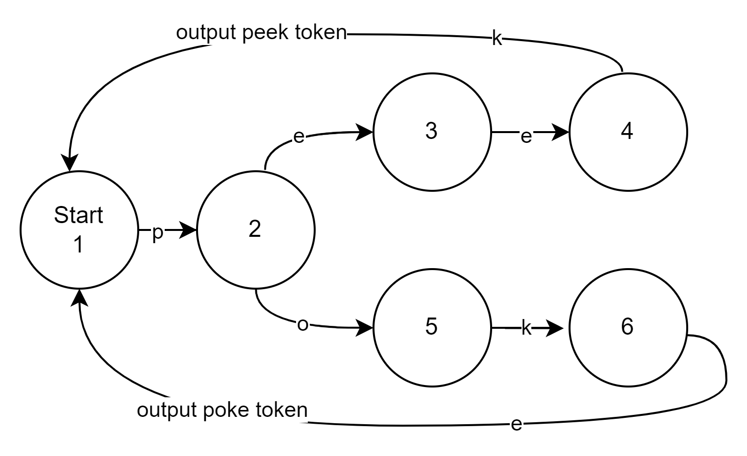
Let’s take an example:
Let’s take a simple language with “peek” and “poke” as the only two key words.

Slide 40
Let’s take an example:
Let’s use a table to show our states. Assume: all other input is error.
State | Input | Next State | Token to Output
1 | p | 2
2 | e | 3
2 | o | 5
3 | e | 4
4 | k | 1 | peek
5 | k | 6
6 | e | 1 | poke

Slide 41
Things to notice about this approach
One state (2) had multiple rows.
This isn’t a lot of fun to build the table, but it is pretty easy to build code to run through the input and the table:
while (c = getCharacter ) {
currentState = statemachine [currentState][c]
OutputTokenIfNotNull(currentState)
}

Slide 42
Let’s add some keywords!
alignas
alignof
and
and_eq
asm
auto
bitand
bitor
bool
break
case
catch
char
char16_t
char32_t
class
compl
concept
const
constexpr
const_cast
continue
decltype
default
delete
do
double
dynamic_cast
else
enum
explicit
export
extern
false
float
for
friend
goto
if
inline
int
long
mutable
namespace
new
noexcept
not
not_eq
nullptr
operator
or
or_eq
private
protected
public
register
reinterpret_cast
requires return
short
signed
sizeof
static
static_assert
static_cast
struct
switch
template
this

Slide 43

Let’s add some keywords!
thread_local
throw
true
try
typedef
typeid
typename
union
unsigned
using
virtual
void
volatile
wchar_t
while
xor
xor_eq

Slide 44
If only there were some way to automatically generate code that would read a stream of text and convert it into tokens using a fast state based approach without making me write that table…

Slide 45
What features might we want?
Allow me to specify keywords and handle them automatically
Some regex-like language to handle things like numbers, variable names, etc
Generated code must be fast
Relatively easy to use
Handles overlapping keywords (“for” and “foreach”) sanely

Slide 46

Would you be surprised if I told you that you weren’t the first people to want this?
Michael Lesk – Worked at Bell Labs in the 70’s.
Wrote things like tbl, refer and uucp for Unix.
Michael’s coauthor was an intern at Bell Labs
by the name of Eric Schmidt. Yes, Google’s Eric Schmidt.
And something that we will talk about today - lex

Slide 47
%{
#include “tokens.h"
%}
digit [0-9]
letter [a-zA-Z]
%%
"+" { return PLUS; }
"-" { return MINUS; }
"*" { return TIMES; }
"/" { return SLASH; }
"(" { return LPAREN; }
")" { return RPAREN; }
";" { return SEMICOLON; }
"," { return COMMA; }
"." { return PERIOD; }
":=" { return BECOMES; }
"=" { return EQL; }
"<>" { return NEQ; }
"<" { return LSS; }
">" { return GTR; }
"<=" { return LEQ; }
">=" { return GEQ; }
Put this, literally, in the output
"begin" { return BEGINSYM; }
"call" { return CALLSYM; }
"const" { return CONSTSYM; }
"do" { return DOSYM; }
"end" { return ENDSYM; }
"if" { return IFSYM; }
"odd" { return ODDSYM; }
"procedure" { return PROCSYM; }
"then" { return THENSYM; }
"var" { return VARSYM; }
"while" { return WHILESYM; }
{letter}({letter}|{digit})* {
yylval.id = strdup(yytext);
return IDENT; }
{digit}+ { yylval.num = atoi(yytext);
return NUMBER; }
[ \t\n\r] /* skip whitespace */
. { printf("Unknown character [%c]\n",yytext[0]);
return UNKNOWN; }
%%
Definitions
Section
Separator
yylval is like our “lexeme”;
id = text,
num = int
yytext is the string we are looking at

Slide 48
How does all of this work?
You run this code through “lex”. Lex generates a function called yyparse(). Why “yy”? – primitive namespacing.
You call yyparse() over and over until it returns 0 (EOF)
We could easily write something that uses this to generate our list of lexemes, so long as we write in C++ (which will compile the “C” code that lex generates) OR we use some other way to get to the C code (JNI?)

Slide 49
How does all of this work under the hood?
It generates a state machine!
The end state(s) of the state machine are the code “chunks” that you saw before ({return “PLUS”;})
After the end state, it returns to the start state and runs again until it runs out of text (i.e. getc() fails)
It uses a little bit of look-ahead (actually, “ungetc()”) when you have 2 keywords that could overlap (for and foreach). This get a little crazy when you have a variable called foreach1 – it reads until it can determine that it is a variable name, not a keyword. But the state machine “handles it” – it keeps reading until it can’t match any more.

Slide 50
This isn’t the 70’s – I don’t want to use C!
http://www.jflex.de/ - Lex for Java
http://irony.codeplex.com/ - A fluent language generator for C#
http://gplex.codeplex.com/ - Lex for C#
http://www.dabeaz.com/ply/ - Lex (and Yacc – that’s later in the course) for Python

Slide 51
Let’s bring it all together!
A Lexer reads input text and tokenizes it – converts it to a list of lexemes.
This simplifies the job for the rest of the compiler or interpreter – it is looking through a smaller amount of memory (faster) and it doesn’t have to “worry about” backtracking or EOF conditions
Breaking the problem up makes it more testable, more understandable and makes it possible to use simple tools to generate some of the more tedious parts of your program!

Slide 52
Editorializing: Don’t use lexer generators
Programs that generate other programs are painful to work with:
You have to debug code you didn’t write
You have to learn a new language
It’s an extra step in your build process
Might be translation bugs
Hand-writing a lexer isn’t that hard…

Slide 53
How I do it…
I use a state machine, but I don’t search for keywords in the states, just “word”.
I then look up each word to see if it is a keyword.
If so, Output the keyword’s token
If not, Output “variable”
Typically 100-200 lines of code. All in a language I know and can debug.

Slide 54
More detail
I make each state a method. That’s helpful because it puts a name on the state, plus it breaks the code up to be readable.
One little problem – we need to be able to peek at the next character without using it. I make a small support class for this. That class “holds” the whole string, and I can call:
public char getChar() // gets one character
public char peek() // returns the next character without “using” it

Slide 55
Pseudo-code for the calculator
main (String incomingLine)
h = new StringHandler(incomingLine);
while (h.hasData())
if (h.peek().isDigit()) processDigits();
else if (h.peek() == ‘.’) processDigits();
else if (h.peek() == ‘ ‘) ; // do nothing
else processSymbol()

Slide 56
ProcessDigits
processDigits
boolean foundPoint = false
while (h.hasData() &&
(h.peek().isDigit() || h.peek() == ‘.’))
char c = h.getChar()
currentString+=c
if (c == ‘.’ && foundPoint == true) throw
else if (c==‘.’) foundPoint = true;
tokens.append(new Token(TokenType.NUMBER, currentString)

Slide 57
processSymbol – the ugly way
processSymbol()
char c = h.getChar()
if (c == ‘+’)
tokens.append(new Token(TokenType.PLUS,null)
else if (c == ‘-’)
tokens.append(new Token(TokenType.MINUS,null)
else if (c == ‘*’)
tokens.append(new Token(TokenType.TIMES,null)
else if (c == ‘/’)
tokens.append(new Token(TokenType.DIVIDE,null)
else throw exception

Slide 58
processSymbol – the nice way
HashMap<char,TokenType> knownSymbols = new HashMap<> {{
put (‘+’,TokenType.PLUS);
put (‘-’,TokenType.MINUS);
put (‘*’,TokenType.TIMES);
put (‘/’,TokenType.DIVIDE); }}; // you can keep going!
processSymbol()
char c = h.getChar()
if (knownSymbols.containsKey(c))
tokens.append(new Token(knownSymbols.get(c),null)
else throw exception

Slide 59
Processing Words
This is similar to processDigits in the way that it accumulates letters. Consider, though, that variable names are also words. So you need to handle anything that a variable name can have.
This is also similar to processSymbol, except that we use a hash map of string, TokenType. This allows us to find keywords (for, if, else, while, etc.) in the language correctly.

Slide 60
Comments and Quotes
Most languages have comments and strings in quotes. These are actually not as hard as they seem.
In “main”, you detect the starting character (like a “) and call processQuote or processComment.
One other thing to consider – does indentation matter? It does in some languages (like Python) but not in others (like Java). This, too, is not terribly hard.

Slide 61
Conclusion
Lexical analysis is the transformation/grouping of characters into tokens – strings with a type.
Lexical analysis is typically done with state machines. I put my states into methods for readability.
Using hash maps to find known items (keywords, symbols) is nicer to work with than building complex state machines.

